Slide 1
Web API Design
Puja Pramudya | Technology Director, Radya Labs

Slide 2
01 | Introduction to Web API
Jeremy Likness | Principal Architect
Christopher Harrison | Content Developer

Slide 3
Module Overview
ASP.NET Web API
Web API Design
REST

Slide 4
ASP.NET Web API
Overview

Slide 5
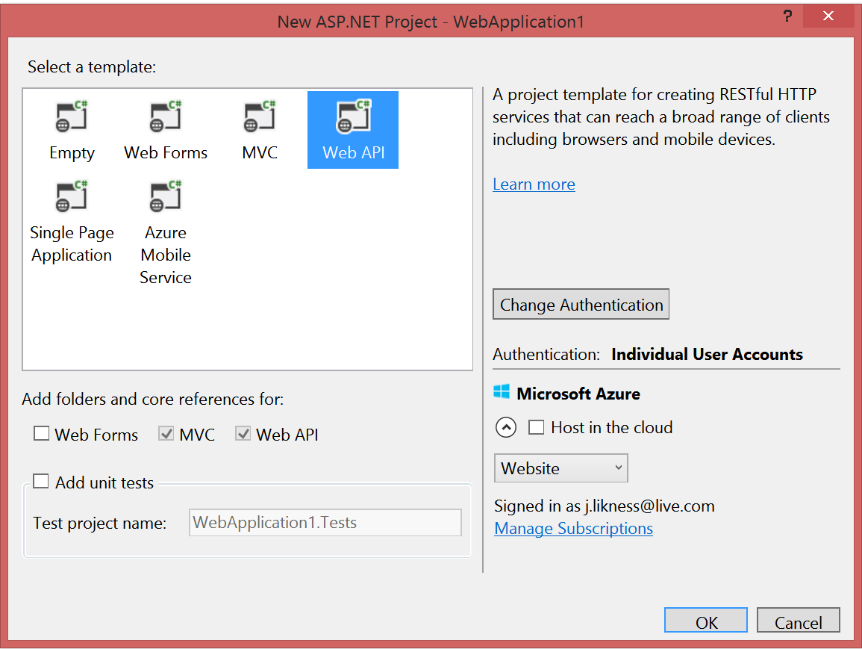
ASP.NET Web API
Option for web applications
Makes it easy to build HTTP-based services
Ideal for RESTful APIs

Slide 6
Web API Design
What this course covers

Slide 7
But what is Web API design?
An intentional approach to building APIs
A “must have” if your APIs will be consumed by third-party services
Attention to details:
How consumable is the API (signature, content negotiation)?
Does it comply with standards (response codes, etc.)?
Is it secure?
How do you handle multiple versions?
Is it truly RESTful?

Slide 8
REST
Introduction and overview of Representational State Transfer

Slide 9
Representational State Transfer (REST)
Client-server
Stateless
Resource-based (vs. remote procedure call)
HTTP methods (GET, POST, PUT, DELETE)
Indempotency and side effects
It’s a style, not a standard
Don’t hate on HATEOAS

Slide 10
Defining the Resource
How to plan the API

Slide 11
Defining the Resource
Collection or Singleton: /widgets or /widgets/1
Navigation: /widgets/1/things or /widgets/1/things/1
Nouns
“Target of a hypertext reference”
Avoid exposing business logic, i.e. if a process requires orchestration across multiple resources, make the process the noun
In Web API, a resource is typically a controller

Slide 12
Resource Examples (Twitter)
Users
Statuses
User_timeline
Home_timeline
Retweets_of_me
Retweets
Retweeters
Followers
Trends

Slide 13
Resource Examples (Azure API Mgmt.)
/apis
/apis/1/operation
/apis/1/policy
/authorizationServers
/certificates
/products
/users
/users/1/subscriptions
Etc.

Slide 14
Verbs
How to plan actions in your API

Slide 15
Verbs and Web API
GET – “read”
POST – “insert” (collection)
PUT – “replace”
DELETE – “remove”
PATCH – “update”
Custom (proceed with caution)

Slide 16
Practical example: Account Transfer
/accounts
How do I transfer $5 from /accounts/1 to /accounts/2?
Attempt #1:
Deduct $5 by PUT /accounts/1
Add $5 by PUT /accounts/2
Problems:
Too much business knowledge
No transfer id to map back to
Lack of transaction – what happens if it breaks after the deduction?
/accounts
/accounts/1
/accounts/2

Slide 17
Practical example: Account Transfer
Attempt #2
Create a transaction under account
POST /accounts/1/transfers { amount: 5, targetAccount: 2 }
Query /accounts/1/transfers/1
Better!
Does /accounts/1 “own” the transaction?
Is it evident that /accounts/2 is impacted?
What if you are navigating /accounts/2 … how do you know a transaction happened?
/accounts
/accounts/1
/transfers

Slide 18
Practical example: Account Transfer
Suggestion
The “noun” is the transaction
POST /transactions { src: 1, amount: 5, tgt: 2 }
Query /transactions/srcAccount or transactions/tgtAccount
(reference back up to /accounts/1 and /accounts/2)
Clear spot to navigate from and models that the accounts are “participants” in the transaction
Guess what …
There is no “right” or “perfect” way
/transfers
/transfers/1
/srcAccount
/tgtAccount

Slide 19
Content Negotiation
How to generate forms (XML, JSON, etc.)

Slide 20
Content Negotiation
Apps consume content in different ways
For example, XML used to be the most popular format
Now of course JSON is most popular
A good service should support multiple content types
A good client will request the favored type
Out of the box, Web API handles provisioning content based on common requests

Slide 21
Content Negotiation

Slide 22
Tools for Testing
Test the API without having to write the entire app!

Slide 23
Tools for Testing
Web API 2.2 Help Page
Generates documentation to validate your API routes and parameters
Install-Package Microsoft.AspNet.WebApi.HelpPage
If your project did not already include MVC, add a call to AreaRegistration.RegisterAllAreas in WebApiConfig
http://www.asp.net/web-api/overview/getting-started-with-aspnet-web-api/creating-api-help-pages

Slide 24
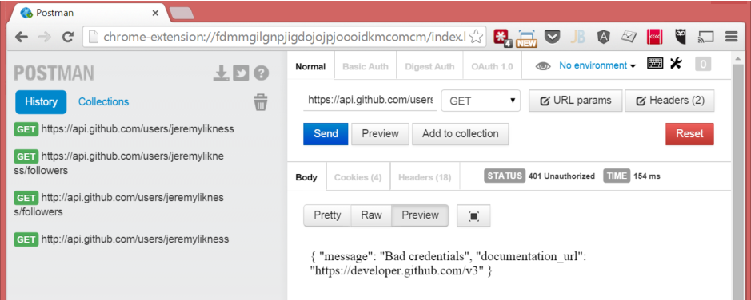
Tools for Testing
Postman Chrome extension
http://bit.ly/postmanext
Fiddler by Telerik
http://www.Telerik.com/fiddler

Slide 25
Using Testing Tools

Slide 26
Routes and Actions
The perfect marriage between a URI and your code

Slide 27
Routes and Actions
Route template
Api/{controller}/public/{resource}/{id}
controller = controller name
action = action (usually omitted)
Provide default values
defaults: new { resource = “widgets” }
Constrain
constraints: new { id = @”\d+” }
Optional
RouteParameter.Optional

Slide 28
Routes and Actions
Select Controller
Route Dictionary
{controller}+ Controller
{controller} [type]
Select Action
HTTP Method
{action}
(params)
Controller .Method()

